Slide 1
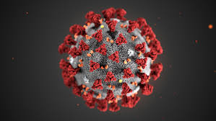
Deep Learning Models for COVID-19, Pneumonia, and Normal Chest X-ray Classification
Karim Eugenio Hamdar, Davide Christian Mancosu Bustos
Department of Mathematics, University of Padua, 2024
Vision and Cognitive Systems 2023-2024

Slide 2
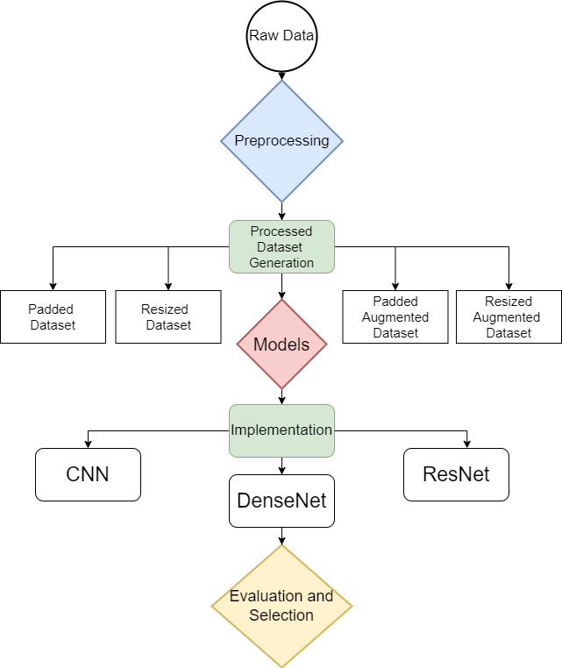
Presentation Pipeline
Introduction
Pre-processing
Models
Results
Conclusions

Slide 3
Introduction
Problem Definition:
Diagnose respiratory condition with chest X-ray images
Three categories: COVID-19, non-COVID pneumonia, and normal conditions
Objective:
Model Comparison
Preprocessing Analysis
Effects of Data Augmentation
Evaluation of Model Performance & Computational Efficiency
CNN
DenseNet
ResNet

Slide 4
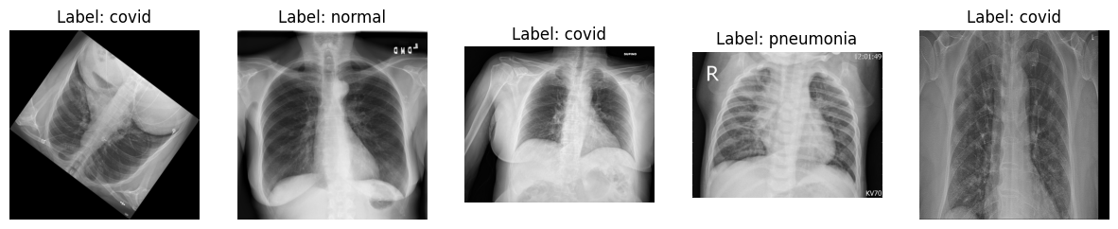
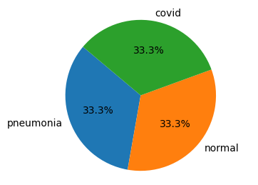
Dataset
4575 images
Balanced dataset:
1525 covid
1525 normal
1525 pneumonia
Fig 1. Sample images

Slide 5
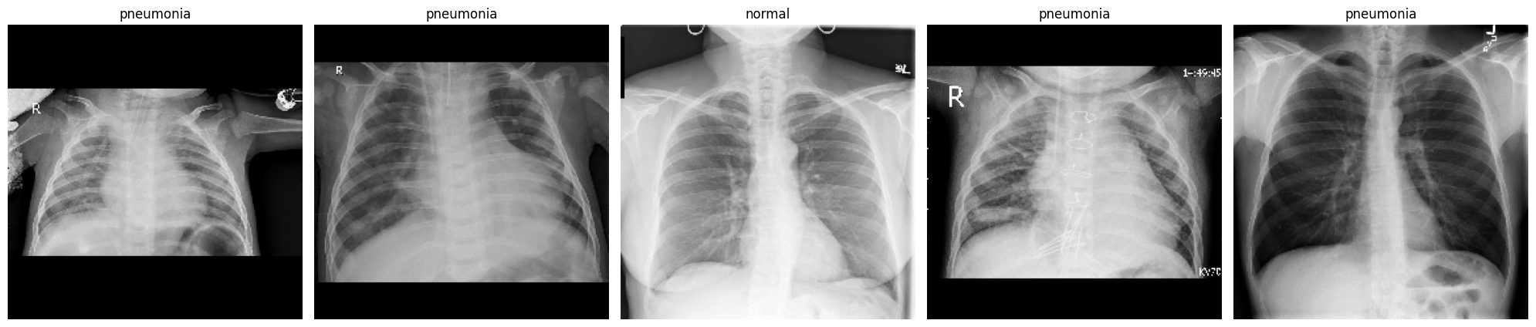
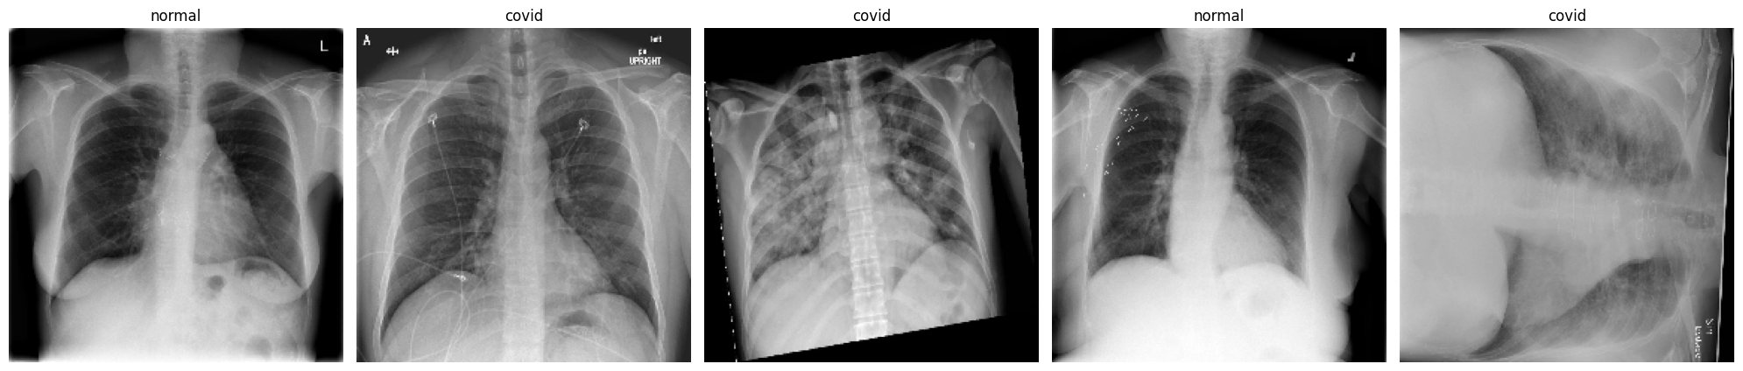
Pre-processing
2 techniques:
Resizing by using cv2.inter_nearest
Padding
Resized to 224x224
Grayscale color mode applied
Data Augmentation used on both resized and padded datasets
Fig 2. Padded images
Fig 3. Resized images

Slide 6
Setup
TensorFlow’s Keras framework was used to implement and train the models.
Optimizer: Adam
Learning rate: 1e-5
Loss: Categorical crossentropy
Epochs: 100
Dataset Splitting:
Original dataset: train(80%), test(20%)
Train Dataset: train(80%), validation(20%)
Stratified Splitting: to ensure consistent class proportions

Slide 7
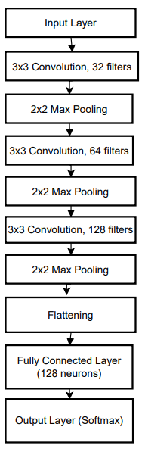
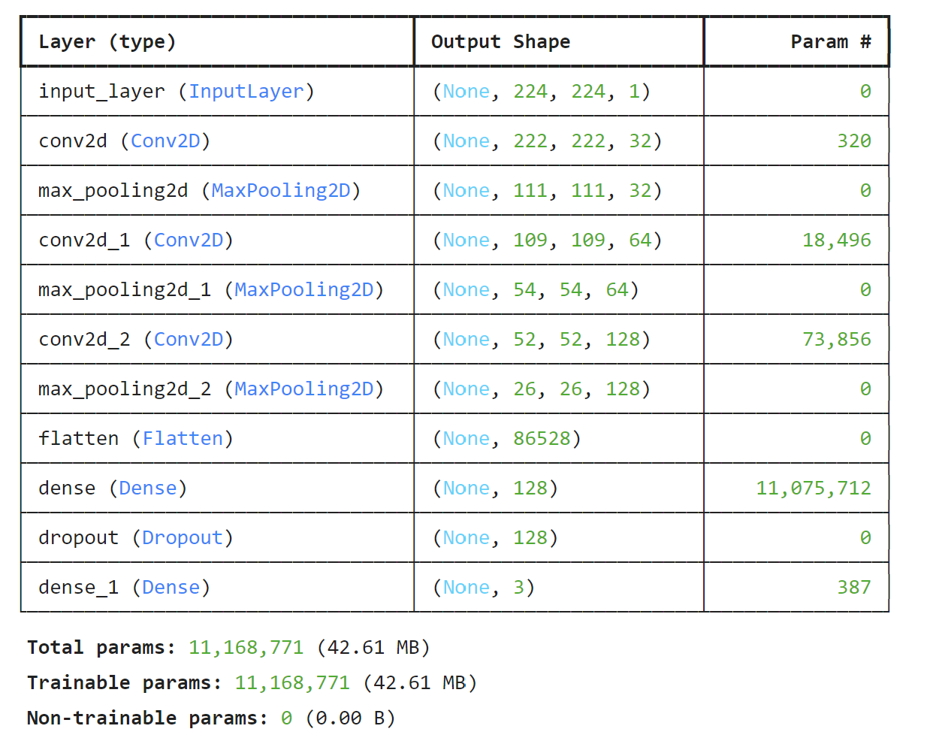


Models: CNN
Total parameters: 11,168,771

Slide 8
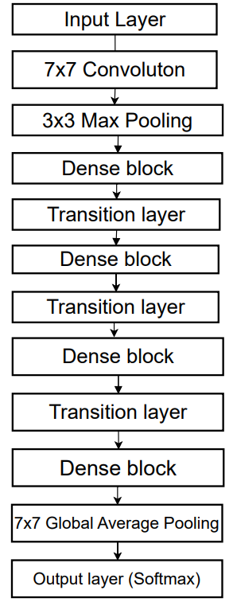
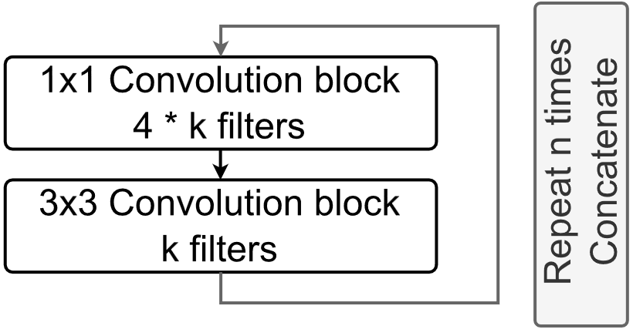
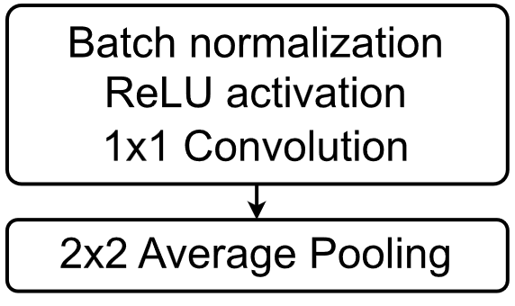
Models: DenseNet
Dense Block
Transition Layer
Dense connectivity
DenseNet-121: 6, 12, 24, 16 repetitions for each dense block
Total parameters: 7,044,547

Slide 9
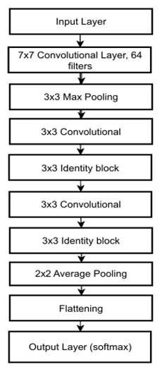
Models: ResNet
Input
Input
1x1 Convolution
Batch Normalization
1x1 Convolution
Batch Normalization
1x1 Convolution
Batch Normalization
3x3 Convolution
Batch Normalization
3x3 Convolution
Batch Normalization
1x1 Convolution
Batch Normalization
1x1 Convolution
Batch Normalization
+
+
Total parameters: 628,227
Identity Block
Convolutional Block

Slide 10
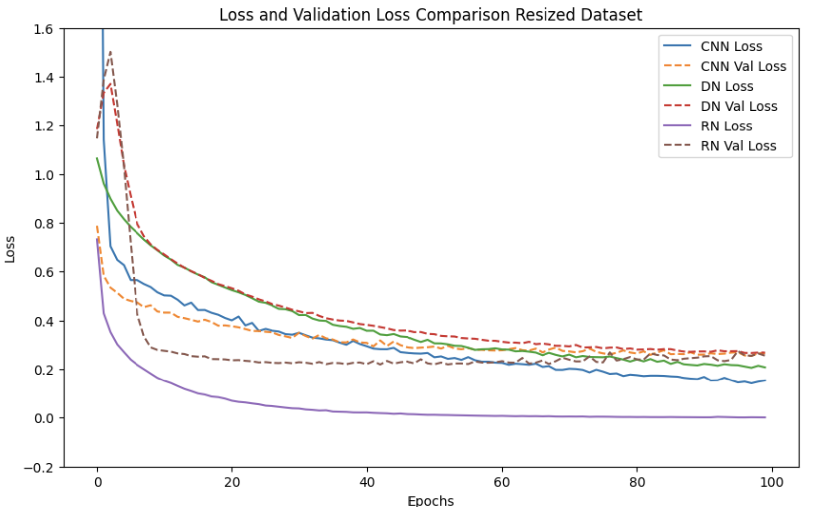
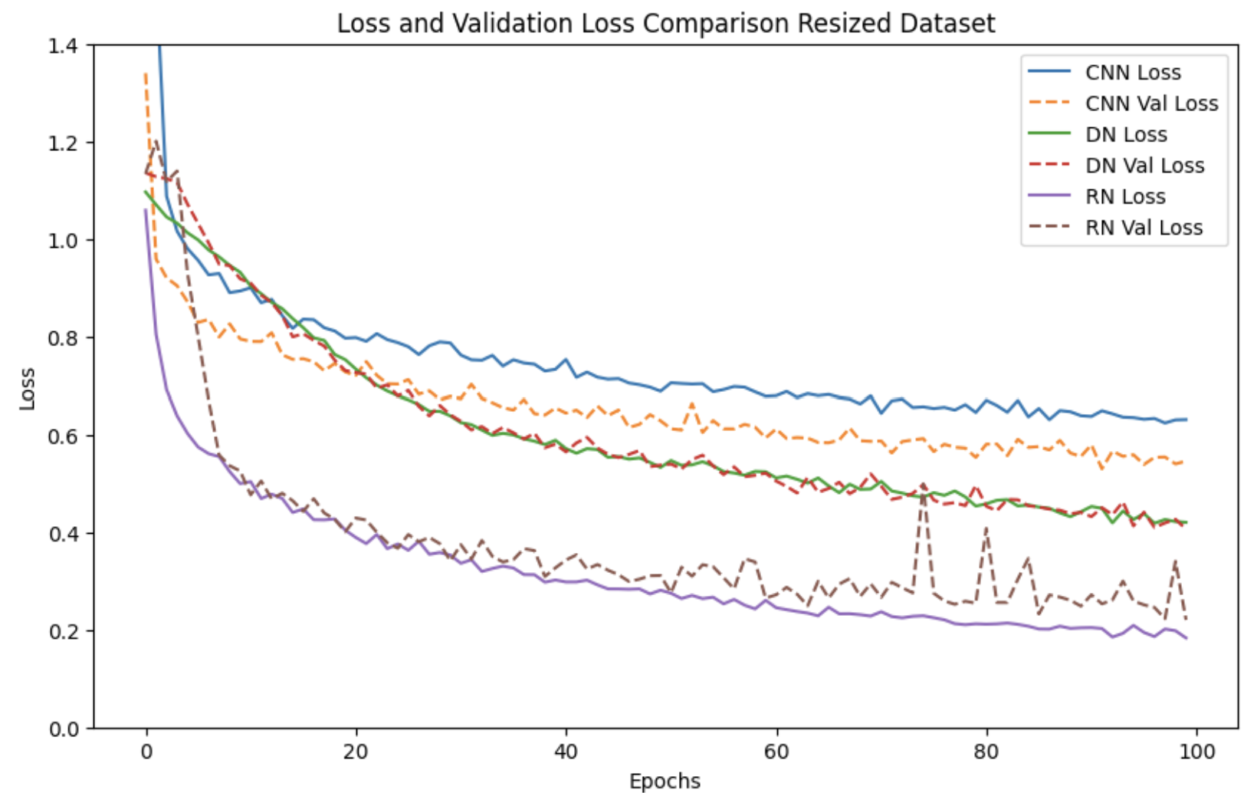
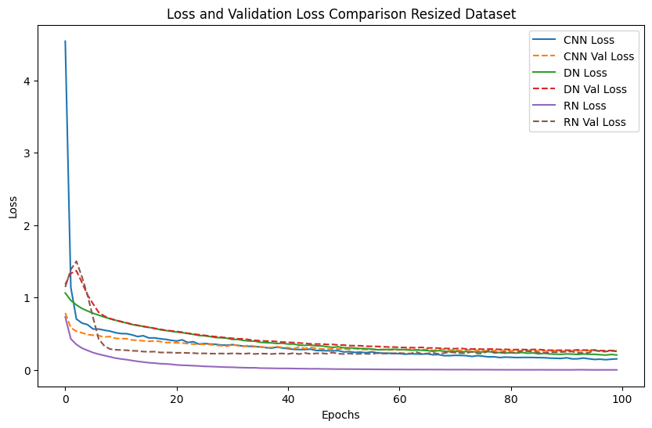
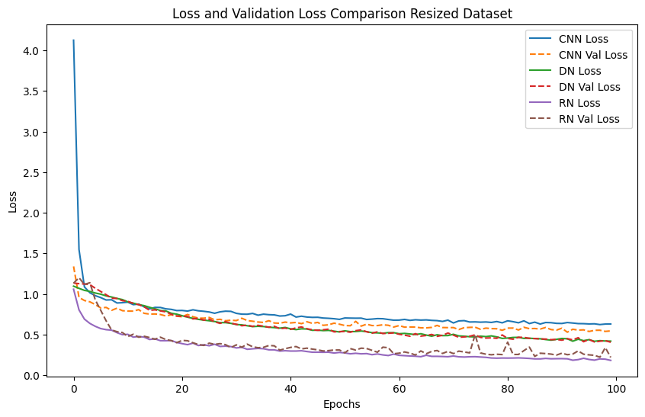
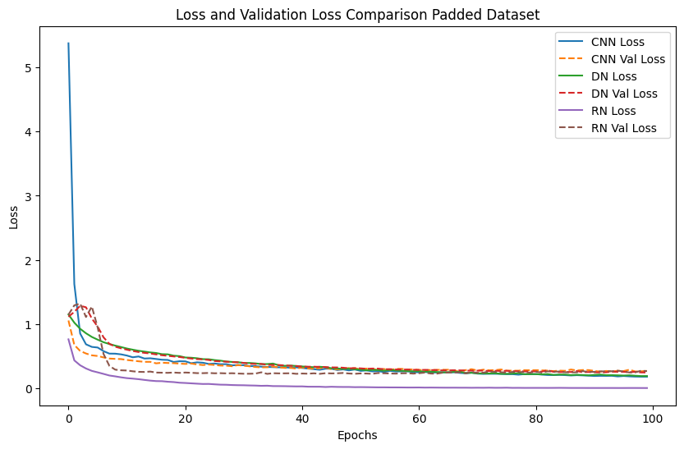
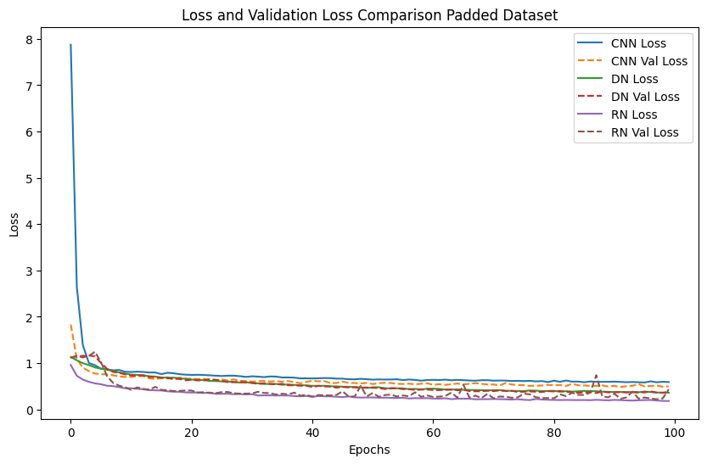
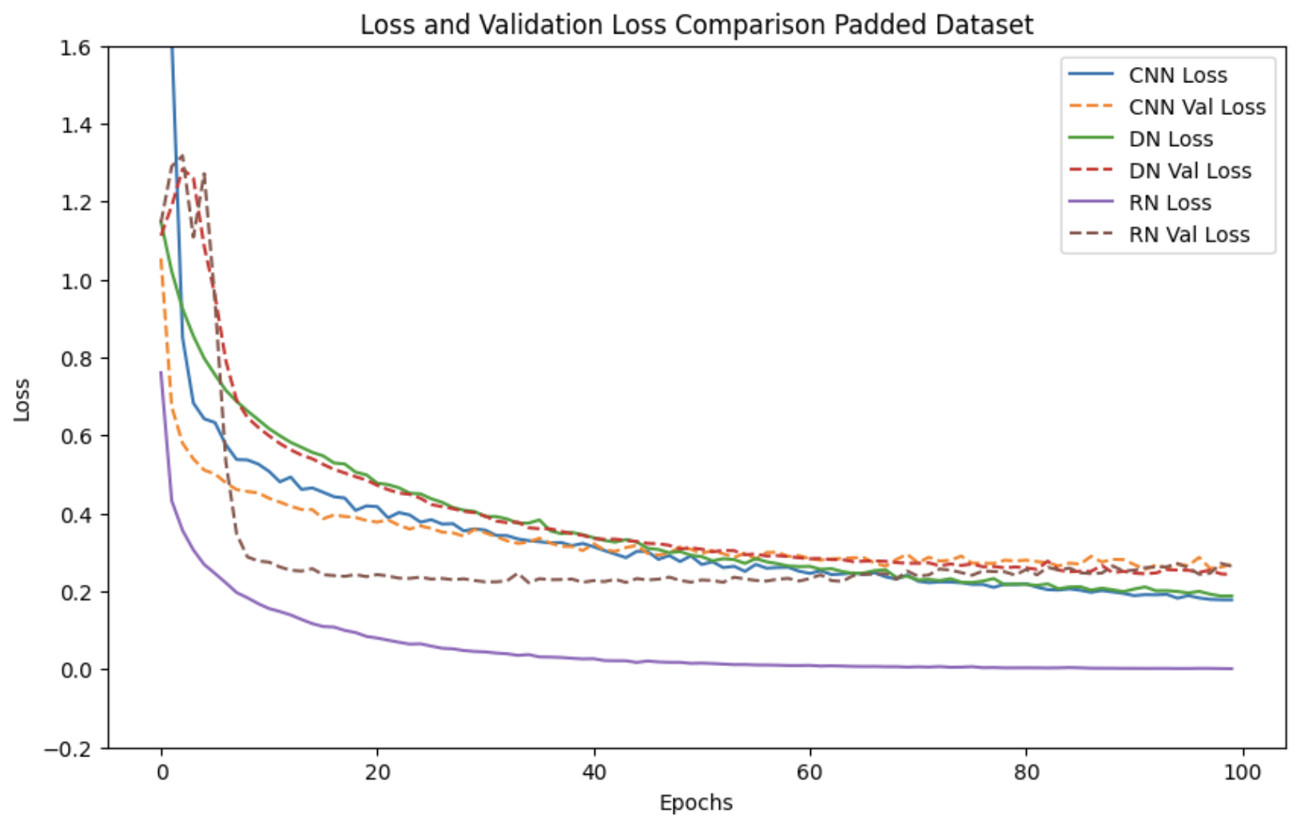
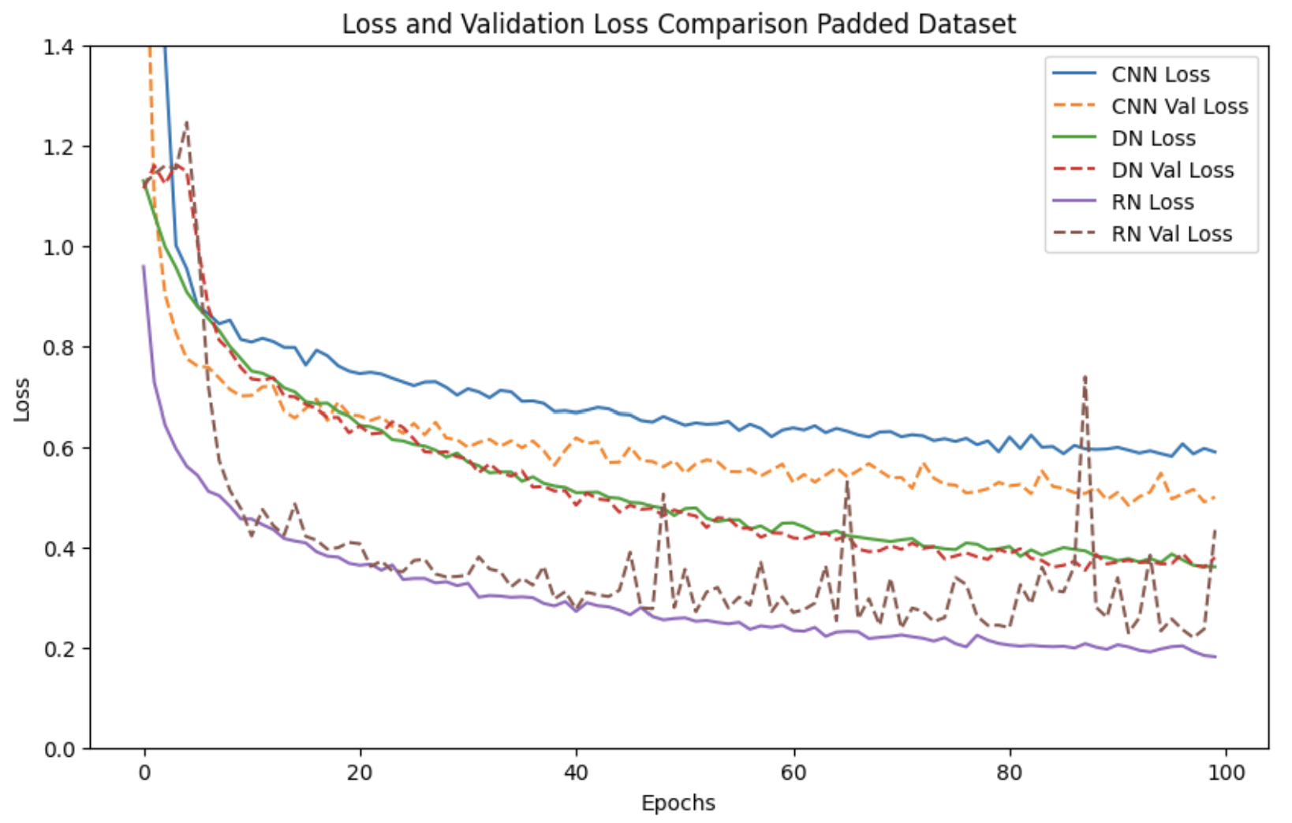
Loss:

Slide 11
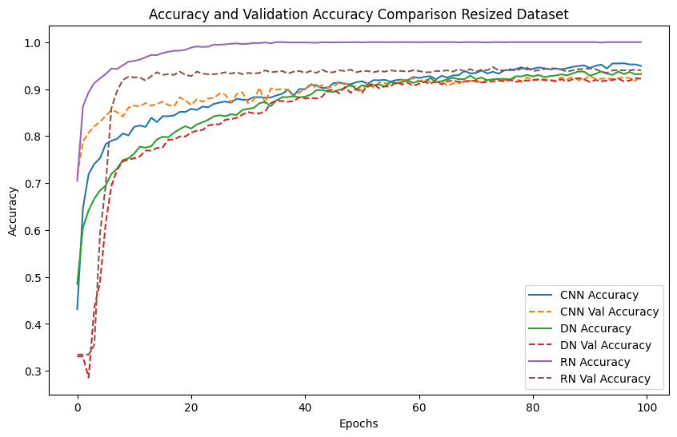
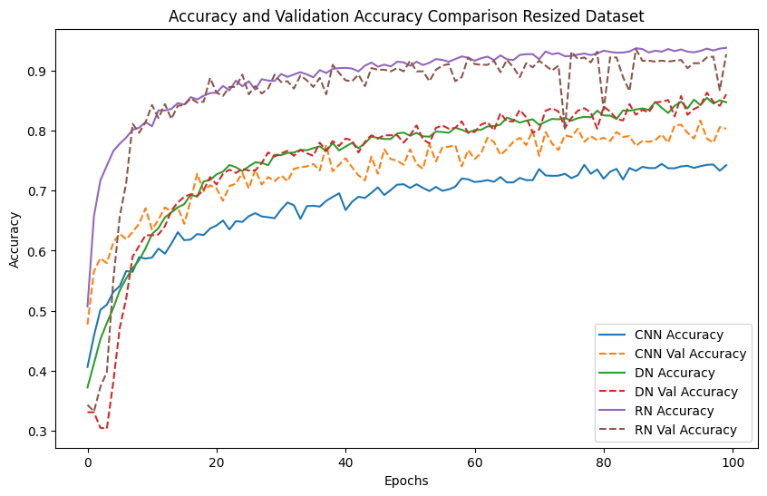
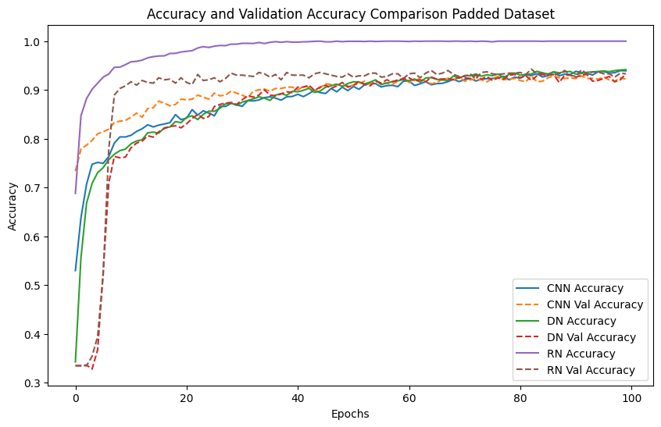
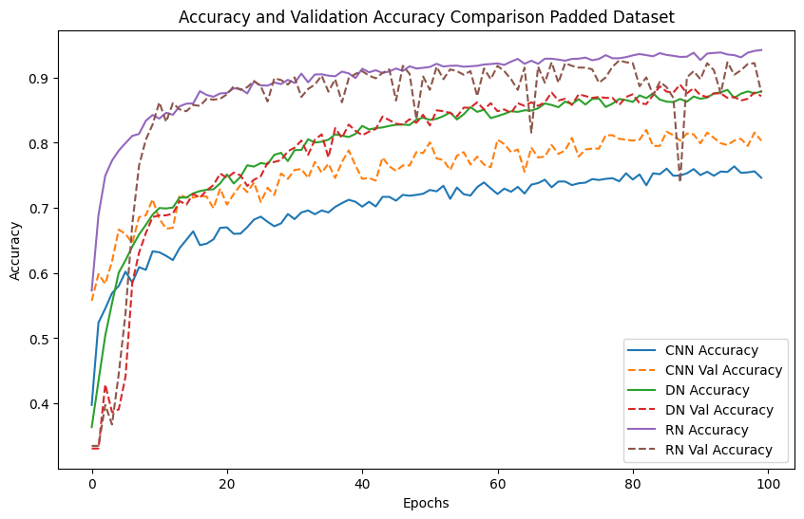
Accuracy:

Slide 12
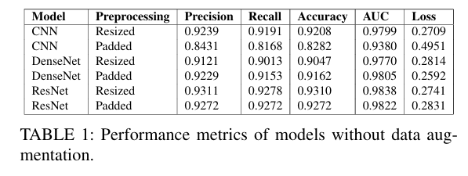
Results: Classification
Resizing Impact on Accuracy:
ResNet:
Best accuracy: 93.11% (Resized, no augmentation)
Key Insight:
Resizing boosts accuracy across all models, especially without augmentation

Slide 13
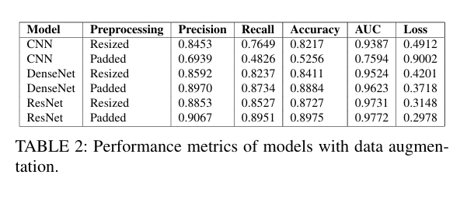
Results: Classification
Data Augmentation & Accuracy:
Inconsistent impact on accuracy across models
CNN: Accuracy dropped to 52.56% (Padding + Augmentation)
DenseNet: Accuracy decreased from 91.62% to 88.84% (Padded images with Augmentation)
ResNet: Similar accuracy decline with augmentation
Key Insight:
Augmentation introduced variability in performance
Padding led to significant accuracy reduction, especially for CNN

Slide 14
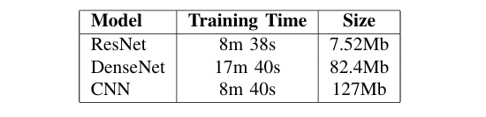
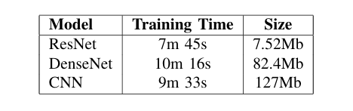
Results: Computational Efficiency
ResNet:
Fastest training time
Lowest memory usage across datasets
DenseNet:
Highest memory usage
Longest training times
CNN:
Larger model size but competitive training time (Resized dataset)
Slower training in Padded dataset
Training time and memory usage with resized dataset
Training time and memory usage with padded dataset.

Slide 15
Conclusions
ResNet: Most effective for chest X-ray classification
DenseNet: Strong performance but high memory and computational demand
CNN: Lightweight and computationally efficient
Preprocessing Impact:
Resizing
Padding

Slide 16
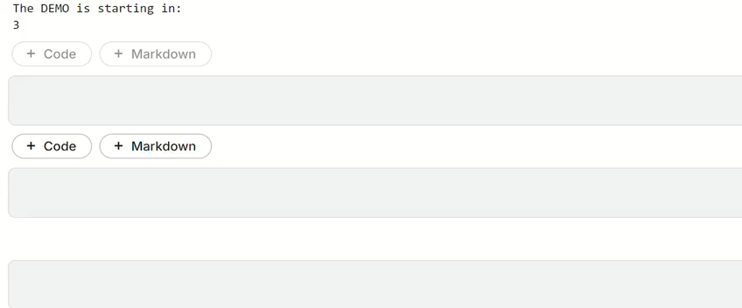
DEMO

